Slide 1
The Role of Corpus Linguistics in Language Decipherment
Sergei Boroday, Ilya Yakubovich
(Institute of Oriental Studies,
Russian Academy of Sciences)

Slide 2
1. General Principles of Decipherment
1. Bilinguals or quasi-bilinguals. (e.g. Rosetta stone, royal titles in Achaemenid vs. Sasanian inscriptions). A usual starting point for the decipherment of languages, whose genetic affiliation cannot be a priori determined. Extent of the decipherment depends on the quantity and the quality of the bilinguals.
2. Combinatory approach. (e.g. the segmentation of Linear B inflectional paradigms leading to its decipherment by Ventris). May require the analysis of textual corpora. The only available starting point for the decipherment of a language for which bilinguals or quasi-bilinguals are not available. May be helpful for determining the typological profile of a language, which in turn may lead to its genetic identification.
3. Etymological approach. (e.g. the decipherment of Old Persian with reliance on Avestan, or the decipherment of Akkadian with reliance on Hebrew). Can be used for the decipherment of languages whose genetic affiliation has been determined. The results depend on the degree of the relationship between the object of the decipherment and its linguistic relatives.
4. Quantitative approach (e.g. problem #1 of the present talk). Requires the analysis of textual corpora. Appears to be most fruitful at the advanced stage of the decipherment. Allows one to distinguish between the rules and the exceptions in the graphic system.

Slide 3
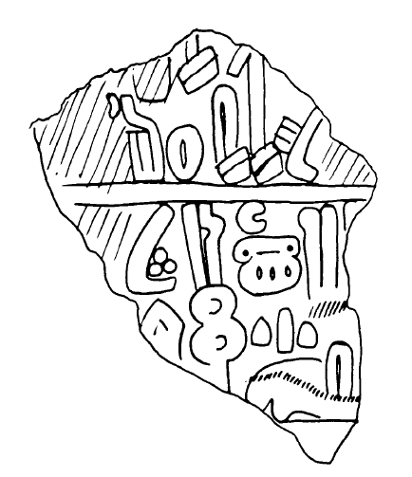
2. Anatolian Hieroglyphs: History of Decipherment
2.1 General Facts.
Anatolian hieroglyphs were invented in the mixed Hittite and Luvian environment, but were predominantly used for writing Luvian.
The script consists of
syllabic signs (V , CV, occasionally CVC(V)),
logograms (transliterated in Latin),
and a limited number of determinatives
and phonetic indicators.

Slide 4
2.2 Bilingual/Digraphic texts.
a) “Tarkondemos Seal” inscribed in the cuneiform and in the Anatolian hieroglyphs was praised by A.Sayce as “Rosetta Stone of Hittite decipherment” in 1880. It led to the establishment of the logograms REX (‘king’) and REGIO (‘land’). The correct reading of the personal name “Tarkondemos” as Targansnawa was achieved only in 1997.
b) The Phoenician and Luvian bilingual of KARATEPE discovered in 1947 confirmed the phonetic values reached through the combinatory approach and revealed the meanings of several new logograms.
c) Inscriptions on ALTINTEPE pythoi, discovered in 1960-62 contained the names of Urartian measurements recorded in Anatolian hieroglyphs. This discovery paved the way to the radical revision of the Luvian transliteration (Hawkins, Morpurgo-Davies, and Neumann 1974).

Slide 5
2.3 Combinatory approach
(to a limited corpus).
The identification of toponyms and personal names that were expected to occur in hieroglyphic inscriptions found in the particular areas led to the establishment of the values of most phonetic signs in the 1930s.
1. tu-wa/i-na-wa/i-ni-sa (URBS) ‘belonging to Tyane’ cf. Hitt. Tuwanuwa
2. ku+ra/i-ku-ma-wa/i-ní-i-sa (URBS) ‘belonging to Gurgum’, cf. Ass. Gurgume
3. i-ma-tú-wa/i-ni (URBS) ‘belonging to Hamath’, cf. Ass. Hammatti
4. mu-wa/i-ta-li-si-sà ‘of Muwattalli (PN)’, cf. Ass. Muttallu
5. Iu+ra/i-hi-li-na ‘Urahilina (PN)’, cf. Ass. Irhuleni
6. wa/i+ra/i-pa-la-wa/i-sa ‘Warpalawa (PN)’, cf. Ass. Urballa

Slide 6
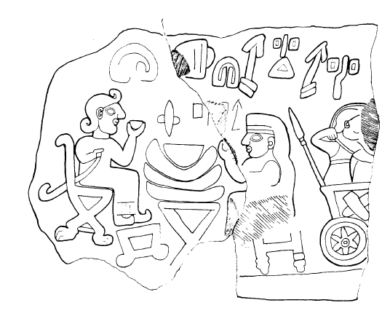
2.4 Etymological approach
The systematic comparison between “Cuneiform Luvian” and “Hieroglyphic Luvian” prompted the radical revision of the Luvian transliteration in the 1970s
CLuv. za- ‘this’ HLuv. za- instead of **ī- ‘this’
CLuv. nom. pl. in-zi HLuw. nom. pl. -i-zi instead of **-a-i
CLuv. 3sg.pres. -i HLuw. 3sg.pres. -i/-ya instead of **-a/-ā

Slide 7
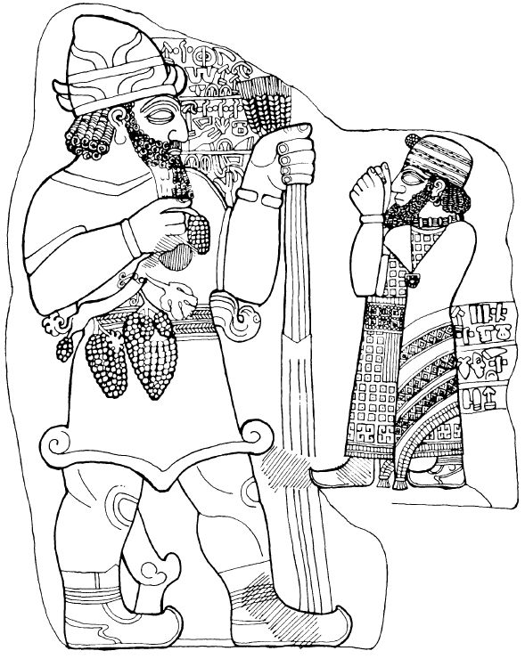
3. Problems requiring corpus-based study

Slide 8
3.1 Signs L 319 and L 172
traditional values <ta₄> and <ta₅>
new values <lá/í> and <là/ì>
(Rieken and Yakubovich, forthcoming)
L 319 L 172

Slide 9
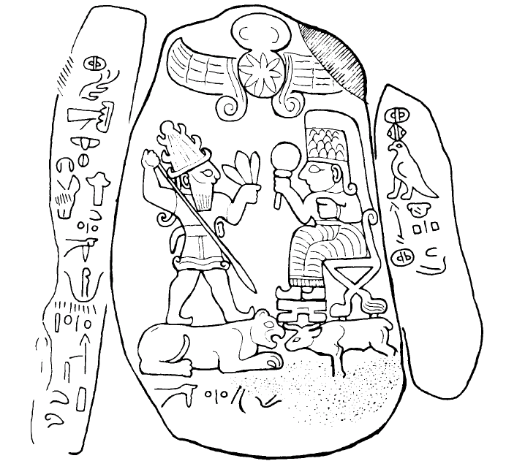
3.1.1 Evidence for the conventional values (established through combinatory method)

Slide 10
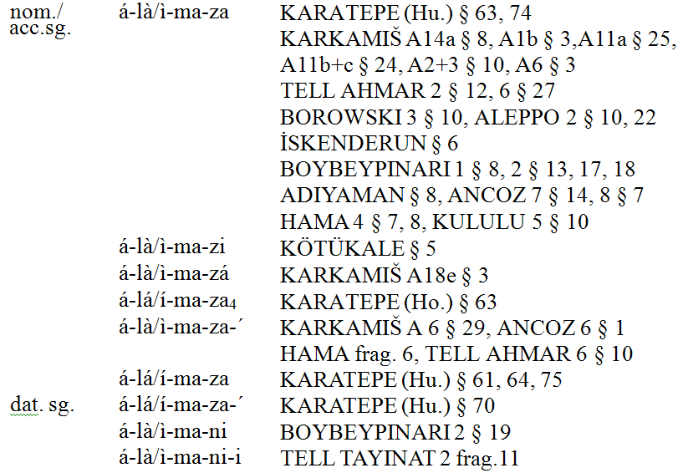
3.1.2 Selected evidence for the new values (established on etymological grounds)
alama(n)- ‘name’ (cf. Lyc. alãma and Hitt. laman ‘name’)

Slide 11
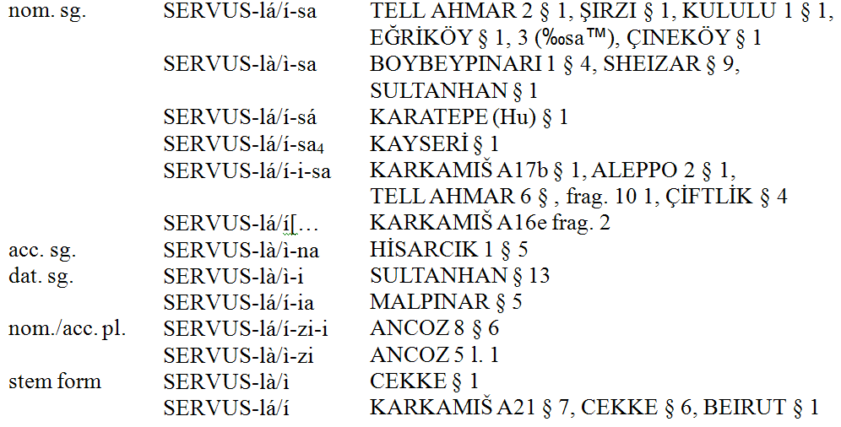
hutarla/i- ‘servant, slave’ (cf. CLuv. hu-u-tar-li-i-ya- ‘belonging to a slave’)

Slide 12
3.1.3 The merger of the intervocalic /d/, /l/ and /r/ in Late Luvian
For the first change, see Morpurgo-Davies (1982/1983)
For the second change, cf.
wa-la- (KARKAMIŠ A23 §9) vs. wa/i+ra/i- (KULULU 2 §3) ‘to die’,
pa-la-sa- (KARKAMIŠ A2+3 §22) vs. pa+ra/i-si (KARKAMIŠ A6 §19) ‘way’,
ka-la/i/u-na- (MARAŞ 8 §7) vs. ka-ru-na- (KARATEPE §7) ‘granary’,
MALLEUS-la/i/u- (KARKAMIŠ A14b §3) vs. MALLEUS-x+ra/i- (MARAŞ 8 §12) ‘to erase’,
tu-ni-ka-la- (KARKAMIŠ A2+3 §22) vs. tu-ni-ka-ra+a- (ASSUR f+g §45) ‘baker’

Slide 13
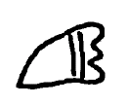
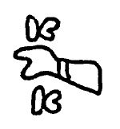
3.2. The word for ‘brother’
traditional reading FRATER-la-, new reading FRATER.LA (Rieken and Yakubovich, forthcoming)
The sign LA (L 175) always accompanies the ideogram L 45 used in the meaning FRATER ‘brother’ (as opposed to INFANS ‘son, child’)
L 175 L 45

Slide 14
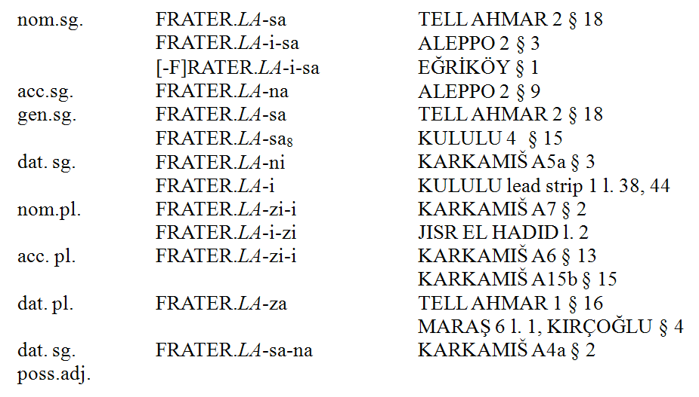
Inflectional Paradigm of *nana/i-, *lana/i- ‘brother’ (cf. CLuw. nana/i- ‘brother’)
This stem occurs as a component of the following personal names:

Slide 15
3.3. The verb ‘to take’
traditional reading: CAPERE / tà-, new reading CAPERE
“Hawkins and I … have already pointed out that it would be possible to read all ta- forms as logographic on the assumption that the sign no.*41 must be read as CAPERE and not as tà. If so, the normal reading of the root would be la- (as in Cun. Luwian). The objection is that for *41, the taking hand, a tà syllabic value is certain – and it would be difficult to understand the origin of this value if the verb was not ta-, but la-. It is of course conceivable that an earlier ta- verb in existence at the time when the syllabary was created was replaced by a la- verb due to phonetic change or lexical replacement.” (Morpurgo Davies 1987: 211-212, fn. 17).
L41

Slide 16
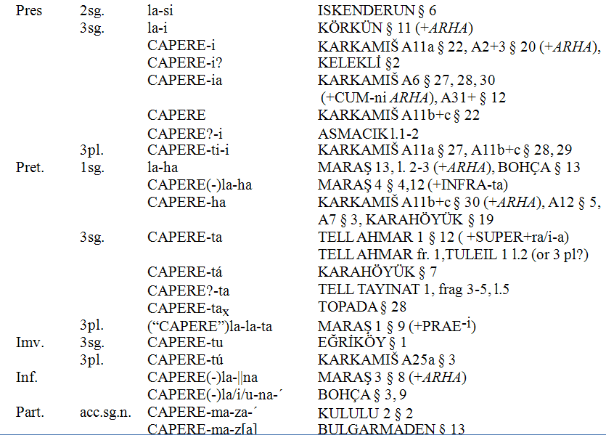
Inflectional paradigm of (la)la-^{i} ‘take’ = CAPERE (Yakubovich 2008)

Slide 17
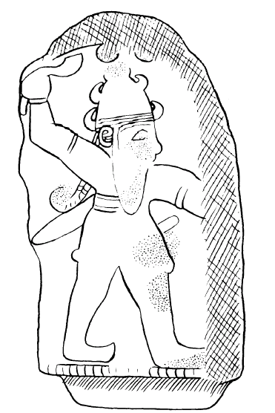
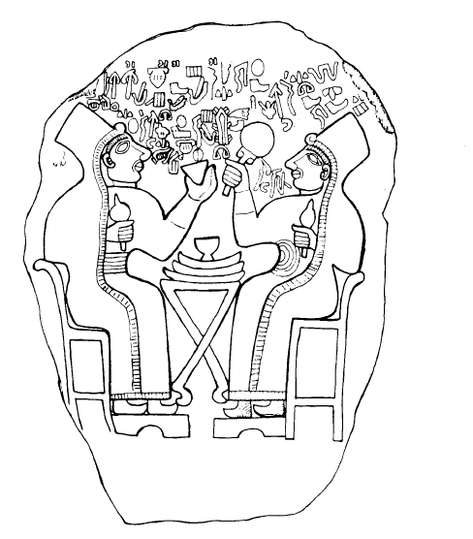
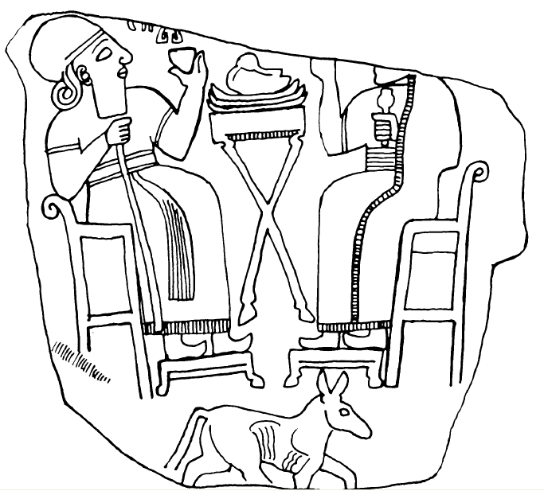
4. Luwian Corpus

Slide 18
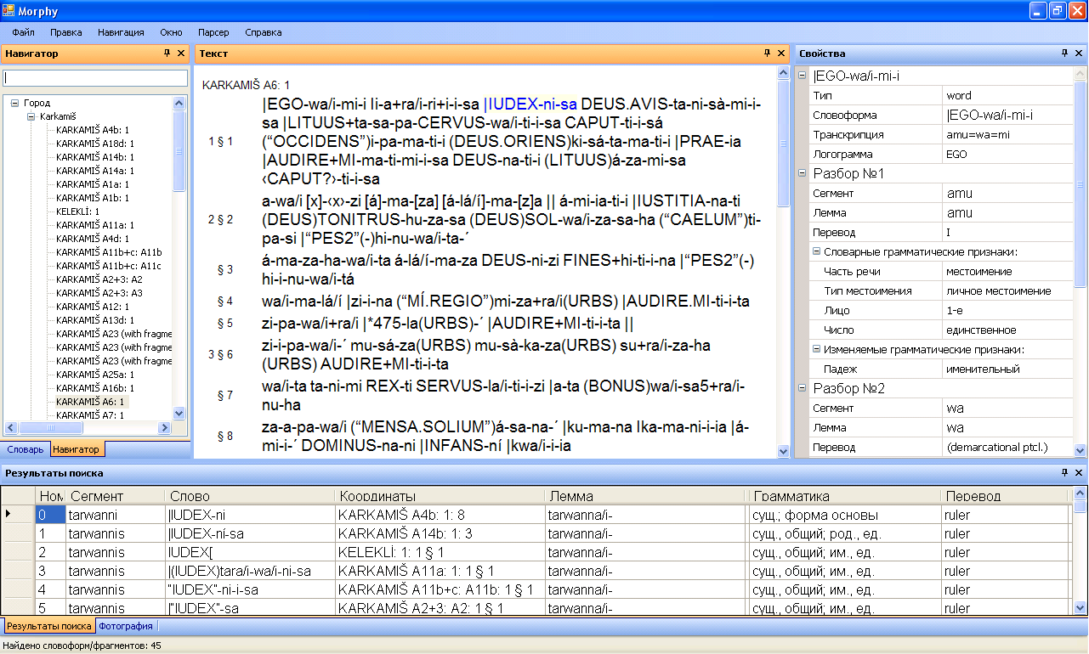

Slide 19
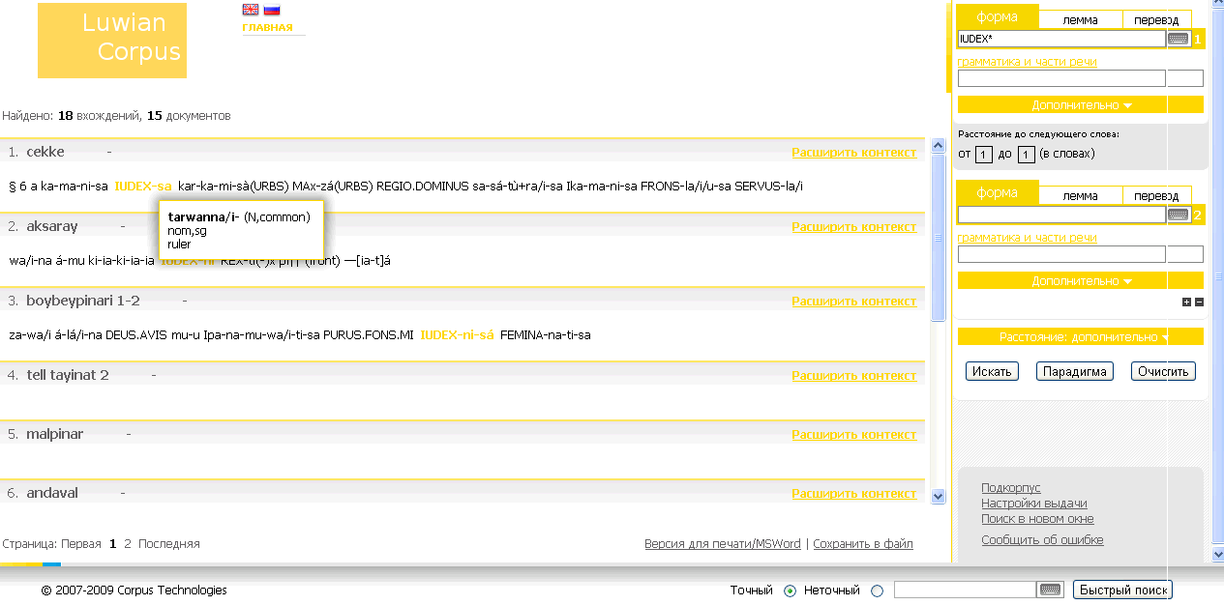
http://web-corpora.net/LuwianCorpus/search/?interface_language=ru

Slide 20
Bibliography
Hawkins, J. David. 2000. Corpus of Hieroglyphic Luvian Inscriptions. Volume I. Part I, II: Texts; Part III: Plates. Berlin-New York: W. de Gruyter.
Hawkins, J. David, Morpurgo-Davies, Anna, and Neumann, Günter. 1974. “Hittite Hieroglyphs and Luwian: New Evidence for the Connection”. Nachrichten der Akademie der Wissenschaften in Göttingen (Philologisch-historische Klasse) 6: 145-97.
Morpurgo-Davies, Anna. 1982/83. “Dentals, Rhotacism and Verbal Endings in the Luwian Languages”. Zeitschrift für Vergleichende Sprachforschung 96: 245-70.
__________1987. “ “To put” and “to stand” in the Luwian Languages”. Studies in Memory of Warren Cowgill (1929-1985). Ed. C. Watkins. Berlin-New York: Walter de Gruyter. Pp. 205-28.
Rieken, Elisabeth and Ilya Yakubovich. “The New Values of Luvian Signs L 319 and L 172”. To appear in a Festschrift.
Yakubovich, Ilya. 2008. Sociolinguistics of the Luvian Language. University of Chicago PhD Dissertation.

