Slide 1
Recent ASJP discoveries
Søren Wichmann
Max Planck Institute for Evolutionary Anthropology

Slide 2
Structure of the talk
A skeptical note on probabilistic methods
A mixed quantitative-qualitative procedure for establishing genealogical relationships
Use of ASJP similarities as an initial hypothesis-generator
Inspecting word lists
Applying the comparative method
Case studies
Lepki-Murkim (New Guinea)
Chitimacha-Totozoquean (North & Middle America)
Zuni-Hokan (North America)

Slide 3
A skeptical note on probabilistic methods
“Probabilistic analysis and the language modelling it entails are worthy topics of research, but linguists have rightfully been wary of claims of language relatedness that are based primarily on probabilities. If nothing else, skepticism is aroused when one is informed that a potential long-range relationship whose validity is unclear to experts suddenly becomes a trillion-to-one sure bet when a few equations are brought to bear on the task” (Kessler 2008: 829).

Slide 4
Introducing an empirical basis for distance-based language classification
Automated Similarity Judgment Program

Slide 5
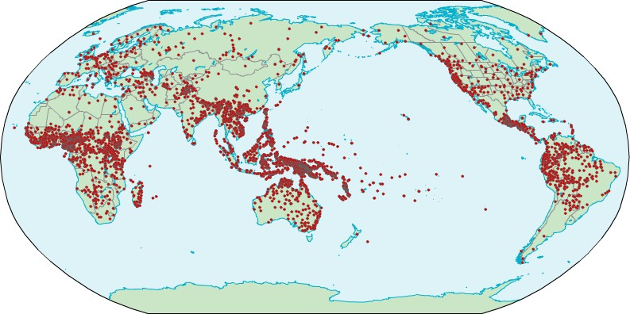
The ASJP database
Map of all 5751 languages and dialects covered in the ASJP database
(database available from http://www.eva.mpg.de/~wichmann/ASJPHomePage.htm,
find this by simply googling „ASJP project“)

Slide 6
Example of word lists (from Chukotko-Kamchatkan)
ALUTOR{…classsification…}
3 61.00 165.00 150 alu alr
1 I x3mm3 //
2 you x3tt3, turi //
3 we muri, muruwwi //
11 one 3nnan //
12 two Nitaq //
18 person Xuyamtawil7~3n //
19 fish 3nn373n //
21 dog xilN3n //
22 louse m3m3ll3 //
23 tree utt37ut //
… ….. …….
100 name n3nn3 //
KORYAK{…classification…}
1 61.00 167.00 3500 kry kpy
1 I x3mmo //
2 you x3CCi, tuyi //
3 we muyi, muyu //
11 one 3nnen //
12 two N3CCeq //
18 person XuyemtewilX~3n //
19 fish 3nn373n //
21 dog werowka //
22 louse m3m3l //
23 tree utt37ut //
… … …
100 name n3nn3 //

Slide 7
An automated similarity measure
Levenshtein distances: the minimum number of steps—substitutions,
insertions or deletions—that it takes to get from one word to another
Germ. Zunge → Eng. tongue
cuN3
tuN3 (substitution)
toN3 (substitution)
toN (deletion)
Or tongue → Zunge
toN
toN3 (insertion)
tuN3 (substitution)
cuN3 (substitution)
= 3 steps, so LD = 3

Slide 8
Weighting Levenshtein distances
divide LD by the length of the longest string compared to get LDN (takes into account typical word lengths of the languages compared),
then divide LDN by the average of LDN‘s among words in the word lists with different meanings to get LDND (takes into account accidental similarity due to similarities in phonological inventories)

Slide 9
Using modified mean distances
to identify new genealogical relationships
Using a conservative classification of language families (by Harald Hammarström), derive mean similarities for all pairs of families and isolates
Modify the mean taking into account that (i) the lower the variability of similarities across language pairs the better the evidence for a relationship and (ii) that the more languages compared the better

Slide 10
Top-ranking pairs
FAMILY 1 | FAMILY 2 | PAIRS | MEAN SIMILARITY | MODIFIED MEAN SIMILARITY
West Timor-Alor | East Timor-Buna | 205 | 8.72 | 29.22
Lepki | Murkim | 2 | 26.64 | 28.19
North Omotic | Mao | 72 | 11.06 | 24.53
Garrwan | Limilngan | 1 | 22.91 | 22.91
Amto-Musan | Left May | 16 | 11.19 | 21.84
Bunaban | Jarrakan | 4 | 13.42 | 19.86
Eastern Daly | Northern Daly | 6 | 16.04 | 19.64
Anson Bay | Northern Daly | 6 | 15.98 | 18.77
Mongolic | Tungusic | 176 | 7.61 | 17.85
Central_Sudanic | Birri | 45 | 7.88 | 17.53
Kiwaian | Waia | 28 | 12.54 | 17.47
Bosavi | Turama-Kikori | 52 | 7.44 | 17.05
Nyulnyulan | Pama-Nyungan | 218 | 4.98 | 16.98
Quechuan | Aymara | 360 | 12.39 | 16.48
Panoan | Tacanan | 115 | 8.32 | 16.28
Central_Sudanic | Kresh-Aja | 90 | 5.74 | 15.97
Kamula | Awin-Pa | 1 | 15.88 | 15.88
Jarrakan | Worrorran | 6 | 8.55 | 15.60
Mirndi | Pama-Nyungan | 436 | 3.53 | 15.37

Slide 11
Complementary method:
Inspecting the ASJP World Tree
The world tree puts together all languages in one big Neighbor-Joining tree
It is only as good as the data put in, and it has clear limitations beyond a time depth of ~5000 years
But within a time depth of ~5000 years there are still relationships to be discovered!
So the ASJP World Tree of Lexical Similarity can be used to look for fruitful suggestions

Slide 12
Not recommended: throwing the
baby out with the bath water
[The ASJP World Tree of Lexical Similarity is]
“a phylogenetic tree where historically correct nodes
are hopelessly mixed with nodes that reflect either
areal convergence (e. g. the closest branch to Sinitic
turns out to be Hmong-Mien instead of Tibeto-Burmese),
differences in the rate of phonetic evolution (…)
(e. g. Kota is not recognized as a South Dravidian
language, although it most certainly is), or straightforward
absurdities (e. g. the closest neighbour of Khoisan
languages turns out to be… Kartvelian!) “
(Starostin 2010: 94)

Slide 13
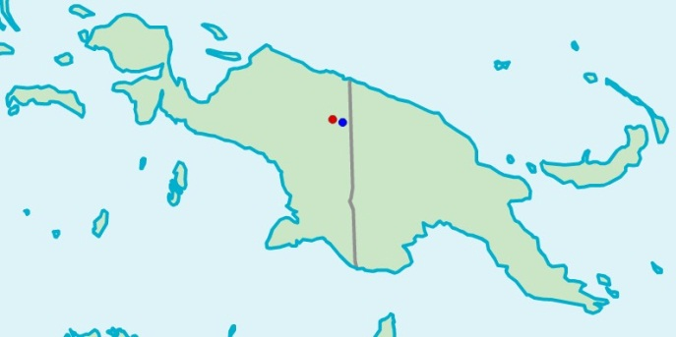
First case study: Lepki-Murkim
Lepki and Murkim are treated as isolates in Ethnologue
and Hammarström (2010), although Ethnologue
does mention the possibility of relatedness between
the two.
Lepki
Murkim

Slide 14
Top-ranking pairs
FAMILY 1 | FAMILY 2 | PAIRS | MEAN SIMILARITY | MODIFIED MEAN SIMILARITY
West Timor-Alor | East Timor-Buna | 205 | 8.72 | 29.22
Lepki | Murkim | 2 | 26.64 | 28.19
North Omotic | Mao | 72 | 11.06 | 24.53
Garrwan | Limilngan | 1 | 22.91 | 22.91
Amto-Musan | Left May | 16 | 11.19 | 21.84
Bunaban | Jarrakan | 4 | 13.42 | 19.86
Eastern Daly | Northern Daly | 6 | 16.04 | 19.64
Anson Bay | Northern Daly | 6 | 15.98 | 18.77
Mongolic | Tungusic | 176 | 7.61 | 17.85
Central_Sudanic | Birri | 45 | 7.88 | 17.53
Kiwaian | Waia | 28 | 12.54 | 17.47
Bosavi | Turama-Kikori | 52 | 7.44 | 17.05
Nyulnyulan | Pama-Nyungan | 218 | 4.98 | 16.98
Quechuan | Aymara | 360 | 12.39 | 16.48
Panoan | Tacanan | 115 | 8.32 | 16.28
Central_Sudanic | Kresh-Aja | 90 | 5.74 | 15.97
Kamula | Awin-Pa | 1 | 15.88 | 15.88
Jarrakan | Worrorran | 6 | 8.55 | 15.60
Mirndi | Pama-Nyungan | 436 | 3.53 | 15.37

Slide 15
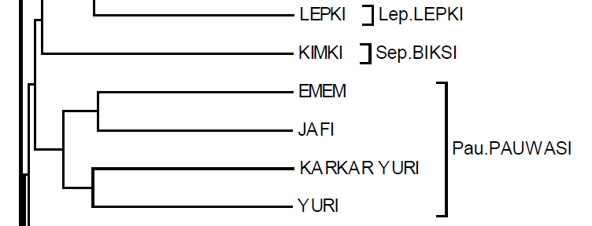
Excerpt from the ASJP World Tree

Slide 16
Likely cognates in the ASJP data
Meaning | lepki [lpe] | milki murkim [rmh] | mot murkim [rmh]
two | kaisi | kais | kais
person | ra | ra | pra
fish | yakEn | kan | kan
louse | nim, nimdEl | om | im
tree | ya | yamul | yamul
leaf | nabai | bw~aik | bw~aik
bone | kow, yiow | kok | kok
ear | bw~i | bw~i | bw~i
eye | yEmon | amol | amol
nose | mogw~an | mo*a | mw~a
tooth | kal | kal | kal
tongue | braw | prouk | porouk
breast | nom | mom | mom
hear | ofao | pao | ha
come | guyo | haro | kw~i
star | Endi | ili | ile
water | kEl | kel | kel
fire | yaoala | yo | yo
path | masin | msan | mesain
night | tiTa | disla | tisla
new | nowal | brel | prel

Slide 17
Second case study: Chitimacha-Totozoquean
Totozoquean (Totonacan + Mixe-Zoquean) established in Brown, Beck, Kondrak, Watters & Wichmann (2011)
A further connection to Chitimacha suggested by the ASJP World Tree (but not strong evidence from the modified similarity scores)

Slide 18
Locations of Totozoquean languages and
Chitimacha (as well as Huave)
(Huave)

Slide 19
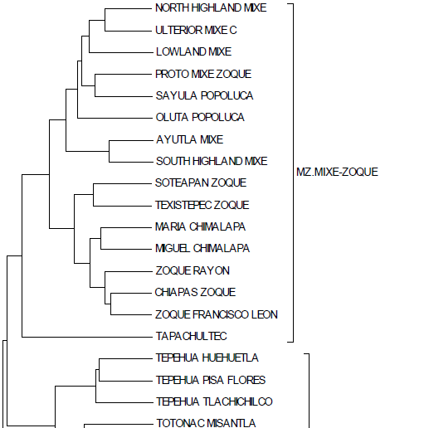
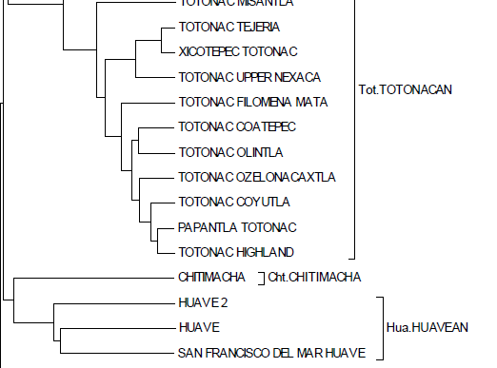
Excerpt from the
ASJP World Tree

Slide 20
Further evidence (see handout)
110 Totozoquean – Chitimacha cognate sets
All cognates contain at least two segments that follow regular sound correspondences
One half of cognates are semantically identical, the rest match very closely
28 sets pertain to the 100-item Swadesh list
34 sets out of 188 Totozoquean reconstructions from Brown et al. (2011) have Chitimacha cognates
Grammatical evidence limited, but suggestive

Slide 21
Clinching evidence
Chitimacha ejectives correspond in a regular fashion to plain consonants followed by creaky vowels in Totonacan
Conversely, Chitimacha plain consonants correspond to plain consonants followed by non-creaky vowels in Totonacan
There is only one (apparent) exception to these rules

Slide 22
Examples
Chitimacha | Totonacan | Meaning
t’eykte- | *(S)ta'x- | to get wet
t’a | *ta' | demonstrative / that
t’a:na | *šta'qat- | mat
naȼ’i(k’i) | *ȼi'nk- | heavy
ȼ’it- | *(S)tiː't- | to cut / to tear
č’ima | *ȼi' | night/black
č’iːš | *ȼiː'š ~ *ȼiː's | bug, worm/cricket
č’ak’umt | *ȼa'qá' | to chew
č’uši | *ȼa'pá' | to sew
č'ami | *šú:'n | sour / bitter
k’eptki | *qa'ps- | fold/to fold
k’eːsi(k’i) | *ku’si | pretty, handsome
k’asma | *kí'spa' | corn
k’ahčin | *kuka't | oak
k’aːste | *ka’sní | to be cold

Slide 23
Third case study: Zuni-Hokan
Zuni generally regarded as an isolate
An unpublished note (not seen by me) by J. P. Harrington claims that Zuni belongs to Hokan
The ASJP modified similarity counts indicate that the families/isolates most similar to Zuni are Salinan, Chimariko, and Pomoan (with Cochimi-Yuman a bit further down the list)
Inspection of ASJP word lists does not reveal an obvious relationship
But when proto-Hokan is compared to Zuni the relationship comes out

Slide 24
Inspection of ASJP word lists
ZUNI 11 one topinte // 23 tree tatta // 39 ear laSokti // 61 die aSe // 66 come iy // 74 star mo7 yaCu // 75 water k"a // 77 stone a // | SALINAN 11 one t7~oL, t7~oixy~u // 23 tree XXX // 39 ear entat, iSk7$o7ol // 61 die axap, Setep // 66 come iax, enoxo // 74 star tacuwan // 75 water Sa7, Ca7 // 77 stone Cx~a7, Sx~ap // | CHIMARIKO 11 one pun, p"un // 23 tree at"a, aca // 39 ear hisam, hiSam // 61 die qe // 66 come XXX // 74 star munu, mono // 75 water a7ka, aqa // 77 stone qa7a, ka //
Note: here one might be able to make a good
Probabilistic argument, but it wouldn’t convince anyone

Slide 25
Better evidence
78 probable lexical cognate sets between proto-Hokan (Kaufman 1988) and Zuni (Newman 1958)
Around a dozen probable cognate affixes
Strong tendency for cognates to belong to universally stable vocabulary:
18% of the 100-item Swadesh list
36% of the ASJP 40-item list of highly stable items

Slide 26
Examples
5 cases where Zuni t : pHokan *Ø
Zuni | pHokan | meaning
te:ya | *+(a)yu | again
taʔwi | *wey | oak
to:šo | *iso | seeds
toselu | *x̣aL or *x̣oL | cattail rush
tina | *(i)Na | to sit

Slide 27
6 cases where Zuni has a –tV syllable not in pHokan
Zuni | pHokan | meaning
ʔawati | *(h)a:wa | mouth
ʔulate | *PáL(a) | to push
ʔate | *(a-)xwá(-ṭ') | blood
kʔaššita | *(a)šwá | fish
kʔeyato | *Ki | to get/be up
šotto | *ša or *sa | to sit

Slide 28
Clinching evidence?
Alternate form for ’to say‘ ± initial i
Zuni | meaning | pHokan | meaning
k^{w}a | say (the form of ʔik^{w}a used after leʔ or les) | k^{y}a | to speak, talk, by speech
ʔik^{w}a | say | ik^{y}'a [a ~ o] | to say, talk

Slide 29
Core references
Brown, Cecil H., David Beck, Grzegorz Kondrak, James K. Watters, and Søren Wichmann. 2011. Totozoquean. International Journal of American Linguistics 22:323–372.
Brown, Cecil H., Søren Wichmann, and David Beck. 2013ms. Chitimacha: A Mesoamerican language in the U.S. Southeast.
Müller, André, Viveka Velupillai, Søren Wichmann, Cecil H. Brown, Pamela Brown, Eric W. Holman, Dik Bakker, Oleg Belyaev, Dmitri Egorov, Robert Mail-Hammer, Anthony Grant, And Kofi Yakpo. 2010. ASJP World Language Tree of Lexical Similarity. Version 3 (July 2010). <http://email.eva.mpg.de/~wichmann/ASJPHomePage.htm>.

