Slide 1
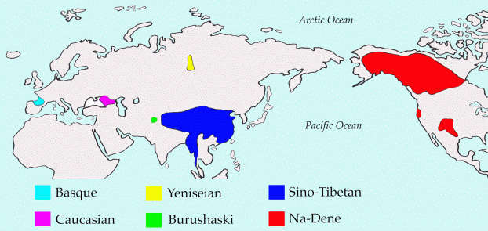
Assessing the Sino-Caucasian Hypothesis
Edward Vajda
(Western Washington University, USA)

Slide 2
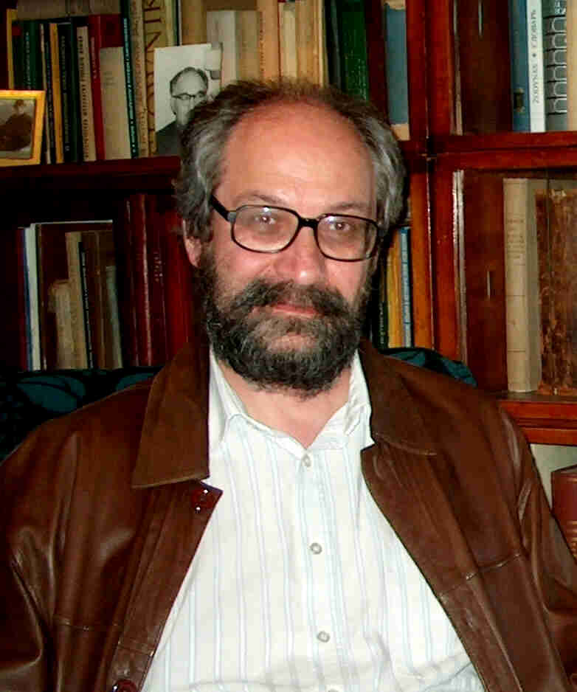
Sergei A. Starostin
Extensive knowledge of many diverse languages and families
Painstakingly accurate compilations of lexical data
Bold consideration of linguistic classification at increasingly deep time depths
Rigorous reconstructions of individual families (Starling), a number of them representing seminal contributions to their respective fields

Slide 3
One of S. A. Starostin’s most innovative proposals:
The Sino-Caucasian Hypothesis (1982)

Slide 4
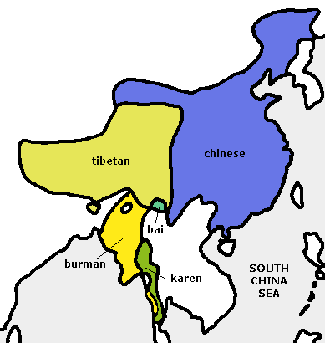
S.A. Starostin’s reconstruction of the phonological system of Old Chinese (1989) is widely known.
Further progress in reconstructing the deeper Proto-Sino-Tibetan will be crucial to demonstrating the family’s external genealogical relations.

Slide 5
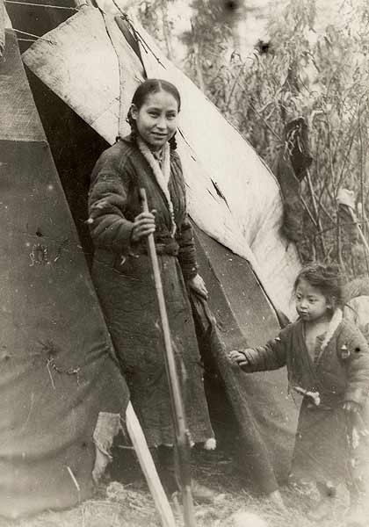
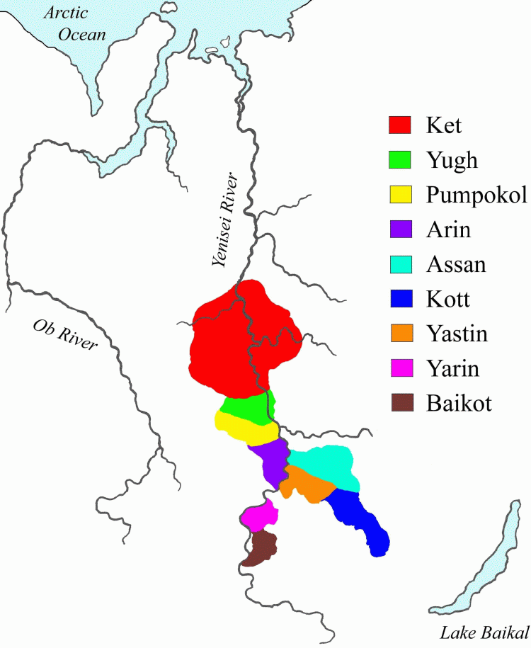
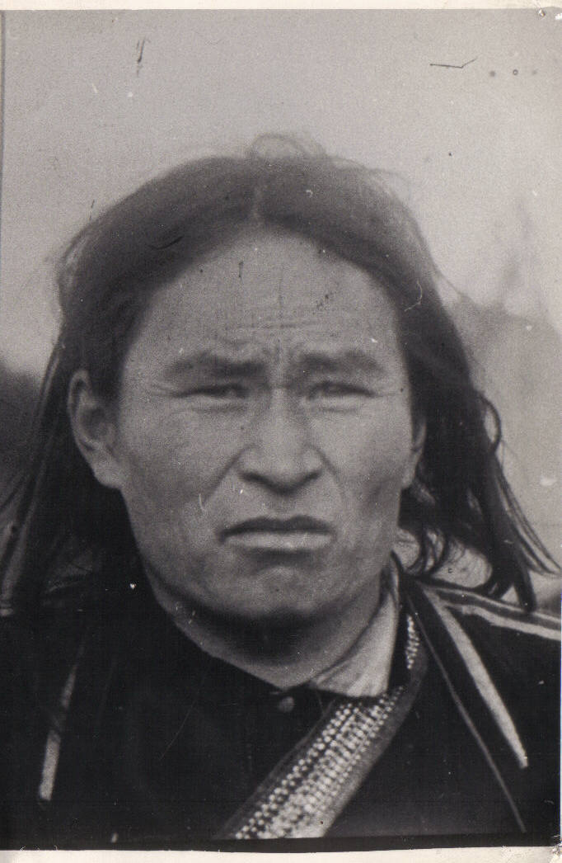
S. A. Starostin’s (1995) reconstructed
Proto-Yeniseian forms are a cornerstone
of Yeniseian historical linguistics.
Current location of Ket speakers
Yeniseian-speaking groups attested in 17th century Tsarist fur tax records
(Key importance of preliminary documentation work by M.A.Castrén, A.P. Dul’zon, G.K.Verner and others)

Slide 6
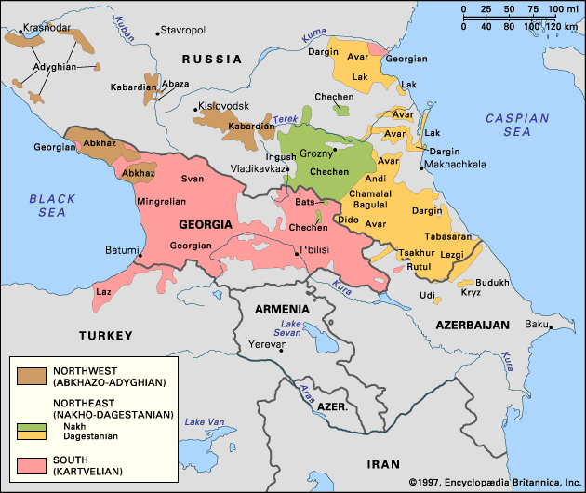
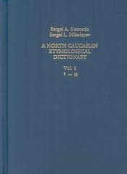
S. L. Nikolaev and S. A. Starostin
A North Caucasian Etymological Dictionary (1994)
proposed extensive lexical evidence for
Abkhaz-Adyghe + Nakh-Daghestanian
(Kartvelian is not connected with the two North Caucasian families)

Slide 7
The broader “Dene-Caucasian” Hypothesis
(investigated by John Bengtson, Vaclav Blažek, and others during the past two decades)

Slide 8
Lexical comparisons and comparisons between various Dene-Caucasian pronominal systems are promising.
However, there is currently no consensus among proponents of this family as to its proper internal subgrouping.

Slide 9
George Starostin (2009)
Closer connection between Burushaski and Yeniseian within some sort of broader “Sino-Caucasian” or “Dene-Caucasian” family.
(George Van Driem’s earlier “Karasukh Hypothesis” was not set in a larger family)

Slide 10
Investigations of a language link between Yeniseian and Na-Dene.
Alfredo Trombetti (1923) Ket-Kott + Athabaskan-Tlingit
Merritt Ruhlen (1998) closer connection between Yeniseian and Na-Dene (including Haida) within an expanded Sino-Caucasian family
E.J.Vajda (2008, 2010, 2012) Yeniseian + Na-Dene (minus Haida), probably within a larger grouping including other Old World families

Slide 11
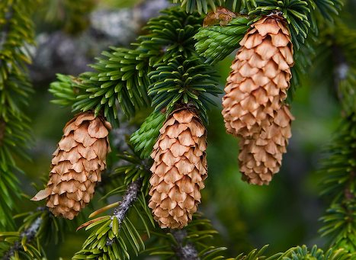
‘conifer tree, branch, needles’
Proto-Yeniseian: *qoˀn
Proto-Athabaskan-Eyak: *Gand

Slide 12
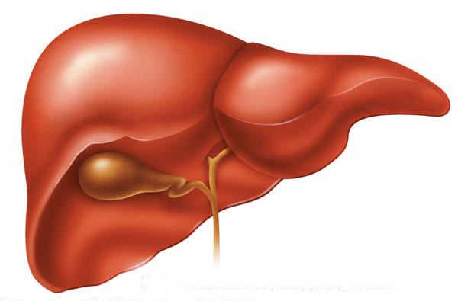
‘liver’
Proto-Yeniseian: *sēˑŋ
Proto-Athabaskan-Eyak: *seŋt’

Slide 13
TONOGENESIS in Yeniseian
from glottalized vs. non-glottalized codas
Na-Dene plain coda corresponds to Yeniseian abrupt tone in the preceding vowel:
‘conifer’ Na-Dene: *Gand Ket: qoˀn
Na-Dene glottalized coda corresponds to Yeniseian high tone in the preceding vowel:
‘liver’ Na-Dene: *seŋt’ Ket: sēˑŋ

Slide 14
Nasal + Obstruent final cluster simplification
Na-Dene Yeniseian
*CvnC → CvhC ~ CṽC Cvn ~ CvnC
‘conifer’ Na-Dene: *Gand Ket: qoˀn ~ qond-
‘dark’ Na-Dene: *q’uns Ket: qoˀn ~ qons-
‘liver’ Na-Dene: *seŋt’ Ket: sēˑŋ ~ seŋ-in
‘wart’ Na-Dene: *xeˑn’tš’ Ket: hɨ̄ˑn ~ hɨt-n
Na-Dene: sporadic retention of nasal
regular retention of obstruent
Yeniseian: regular retention of nasal
sporadic retention of obstruent

Slide 15
‘liver’
Proto-Yeniseian: *sēˑŋ
Proto-Athabaskan-Eyak: *seŋt’
Proto-Sino-Tibetan: *sin
Cognates beyond “Dene-Yeniseian”

Slide 16
*kʷan ~ *gʷen
A striking Dene-Caucasian etymon for “light”

Slide 17
Subgrouping requires the discovery of shared innovations.
Differences in the number of proposed cognates alone cannot easily demonstrate degrees of language relatedness.

Slide 18
1. The need to further refine family-internal reconstruction and historical development.

Slide 19
2. The importance of reconstructing morphology.
(cf. George Starostin 1995 “Morphology of the Kott Verb”)

Slide 20
Edward Vajda (2008, 2010) “A Siberian link to Na-Dene languages” compares Yeniseian and Na-Dene verb morphology.
George Starostin (2012) review of above work, with important criticisms.

Slide 21
Complex templatic morphology highly conservative and promising object of study for historical-comparative linguistics
ATHABASKAN
YENISEIAN
ALGIC
NAKH-
DAGHESTANIAN
MUNDA
BANTU
Johanna Nichols and Ed Vajda (Linguistics Society of America Annual Meeting, January 2012

Slide 22
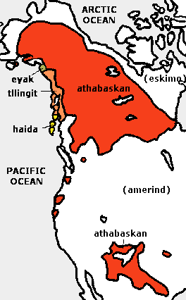
Na-Dene =
Athabaskan-Eyak-Tlingit
Proto-Na-Dene (6000 years ago ?)
Proto-Athabaskan-Eyak
Tlingit Athabaskan Eyak
(no substantive evidence to include Haida, which appears to be an isolate outside the family)
Unrelated languages

Slide 23
Linearly complex verb morphologies are generally not viewed as a promising object of historical-comparative analysis
Found widely in the Americas, Australia, New Guinea, Caucasus, as well as in Bantu, Yeniseian, Munda, Tibeto-Burman, etc.

Slide 24
Proto-Yeniseian
(time depth over 2,000 years)
Ket-Yugh and Kott-Assan are primary branches (Yastin, Yarin, Baikot are Kott dialects)
The position of Arin and Pumpokol is debated.
compact area with substrate river names reflecting all of the languages documented farther north
Proto-Yeniseian

Slide 25
Pumpokol and Arin are difficult to classify due to the paucity of attested vocabulary.
P
U
M
P
O
K
O
L
A
R
I
N
Kott + Assan
Ket + Yugh
?
?
?
?
Common Yeniseian
(broke up at least 2000 years bp)

Slide 26
Arin verbs
Arin: SUBJ-x-a-tum (subject in object position)
ba-x-a-tum ‘I go’
Ket-Yugh: *SUBJ-g-a-denʲ (subject in object position)
Ket: bo-g-a-den ‘I go’ bo-g-on-den ‘I went’
Yugh: bo-g-a-denʲ ‘I go’ bo-g-ol-denʲ ‘I went’
Kott: *d’-a-SUBJ-gin-SUBJ.SUFF
i-gin-aŋ ‘I go’ al-i-gin-aŋ ‘I went’
Arin patterns like Ket-Yugh with the subject marker before the thematic consonant, and also uses b not ŋ as 1st singular agreement marker

Slide 27
Yeniseian reclassified into three primary branches based on verb morphology
P
U
M
P
O
K
O
L
A
R
I
N
Ket - Yugh
Kott-Assan
Keto-Arin
Proto Yeniseian
(at least 2000 years bp)
Yeniseian languages attested In 1600

Slide 28
2. External genealogical relations between families are but one of many interesting facts about the history of the peoples who speak them.
The value of a multidisciplinary approach to studying human prehistory, with language relatedness being only one component.

Slide 29
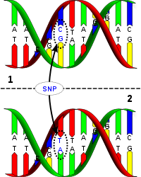
The frequent link between genetic (DNA) relatedness of human populations and the genealogical relatedness of the languages they speak.

Slide 30
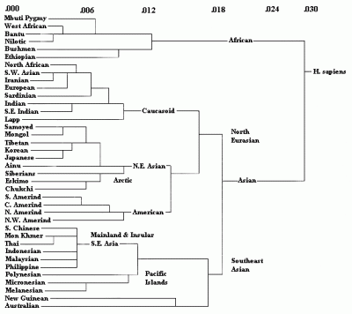
Parallels between human genetic distance and language geneology.
(idea pioneered by Ruhlen and Greenberg but based on autosomal DNA rather than non-recombinant)

Slide 31
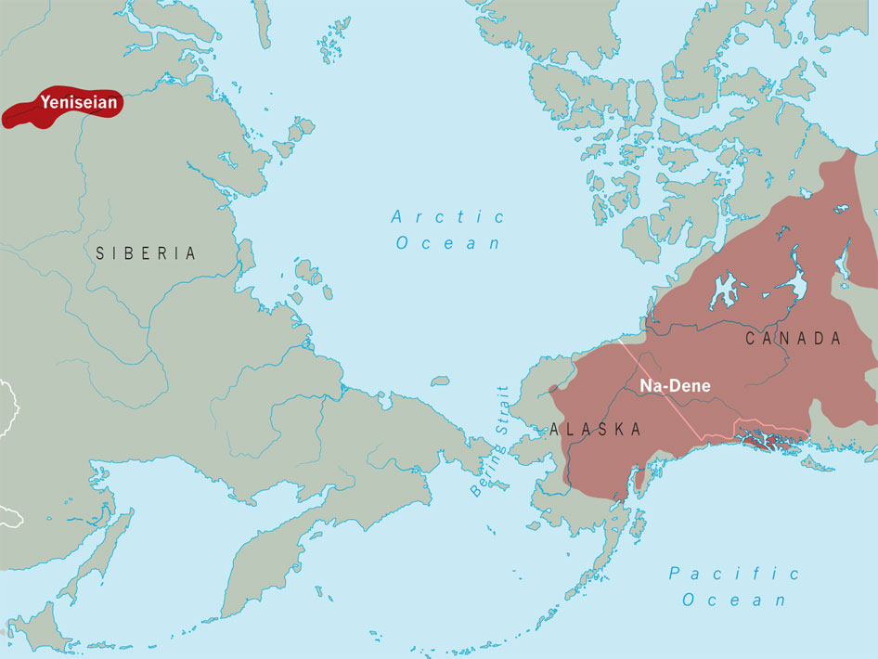
Mitochondrial DNA (Mt-DNA)
Passed on only by the mother, but carried by sons and daughters.

Slide 32
Y-Chromosome DNA (Y-DNA)
Passed on only from father to son.

Slide 33
Assessing prehistory by triangulating evidence from different disciplines
Archaeology (and paleoclimatology)
Mitochondrial DNA (passed on to daughters and sons through the mother)
Y-chromosome DNA (passed from father to son)
Traditional material culture
Indigenous spiritual and intellectual heritage (including folklore motifs)
Language relationship (Important caveat: only language comparison itself can show language relatedness)

Slide 34
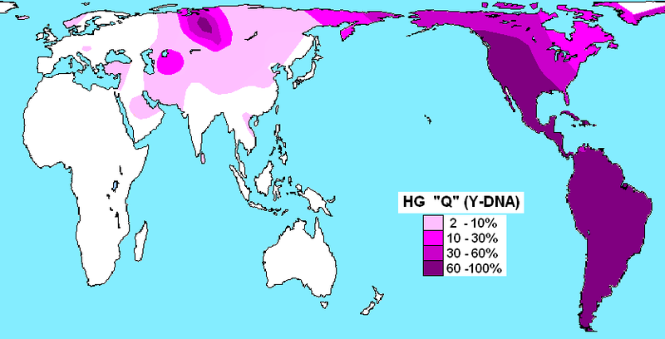
Q1 Subclade (by 15,000 BP
Q1a – Ket
Q1a3a – Native Americans
(arose by 12,000 BP)
Non-Siberian clades of Q
are more distantly related
Y-DNA haplotype Q1a
The predominant male haplogroup in nearly all Native Americans as well as Kets (over 90%) and Selkups (65%). Subclades of Q outside Siberia are more distantly related.

Slide 35
Ket man
Hypothesis: ancient hunters carrying Haplotype Q1a spoke a language ancestral to Ket.
In historic times, Kets were patriarchial and exogamous.
Wives taken from other groups became part of the father’s clan and spoke Ket, as did their children.
Ket man (Hans Findeisen photo, 1927)

Slide 36
Hypothesis: The original predominant Ket Mt-DNA haplogroup was A
Other Ket Mt-DNA haplogroups U, F (now the majority) derive from ancient Baikal fisher-folk.
Mt-haplogroups H, C in the Ket are more recent admixtures from Selkup and other contemporary neighbors.
,
Ket mother
(V.Anuchin photo, 1906)

Slide 37
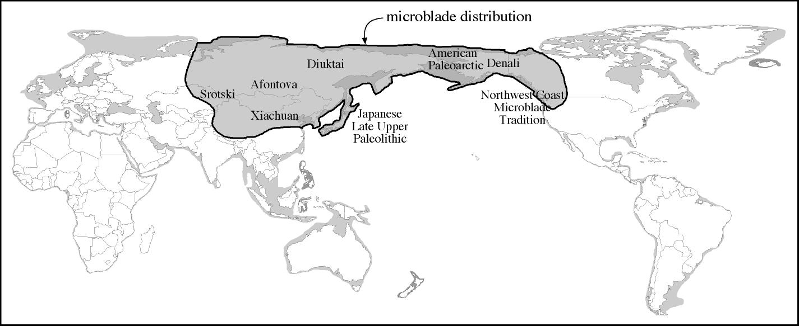
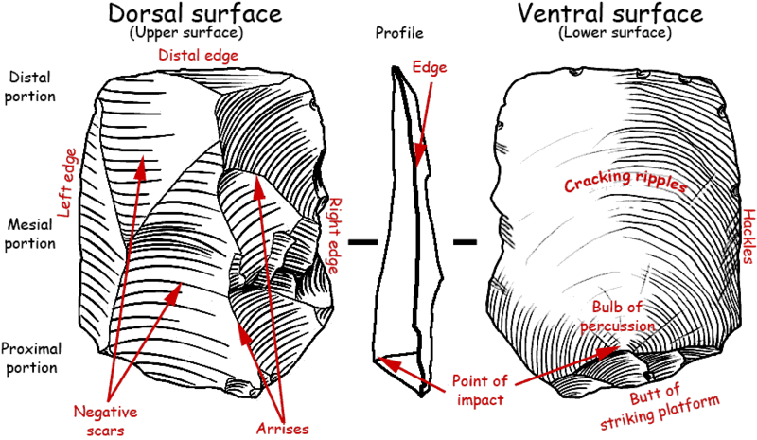
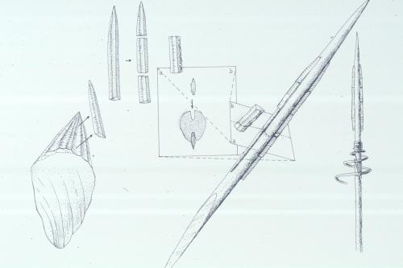
microblades
Q + A
Microblade-creating big game hunters expansion during the last phase of the Pleistocene

Slide 38
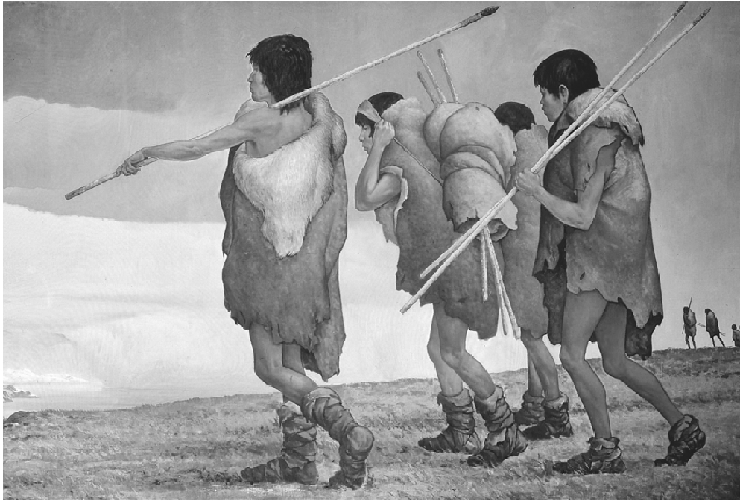
Microblade Hunter
Q + A
Dispersal Hypothesis
Q1 haplogroup became dominant among the already established Pacific Rim populations of Mt-haplogroups B,C,D. The Q males eventually displace the earlier North Pacific Y-haplogroups. They also bring a new Mt-haplogroup: A.

Slide 39
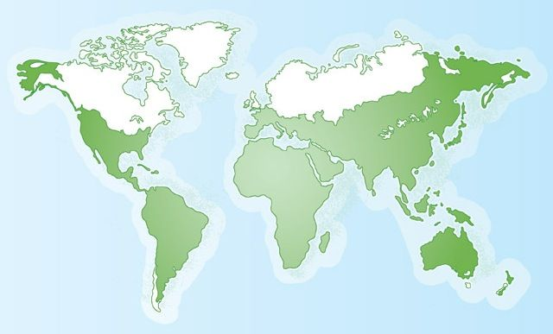
B C D + ?
microblade
hunting culture
Q + A
Pacific Rim tribes of
diverse origins
U
X
C
F
Hypothetical human DNA distribution in Northern Asia prior to the colonization of the Americas (before 15,000 years ago)
Red = Y-DNA haplogroups, Blue = Mt-DNA haplogroups.

Slide 40
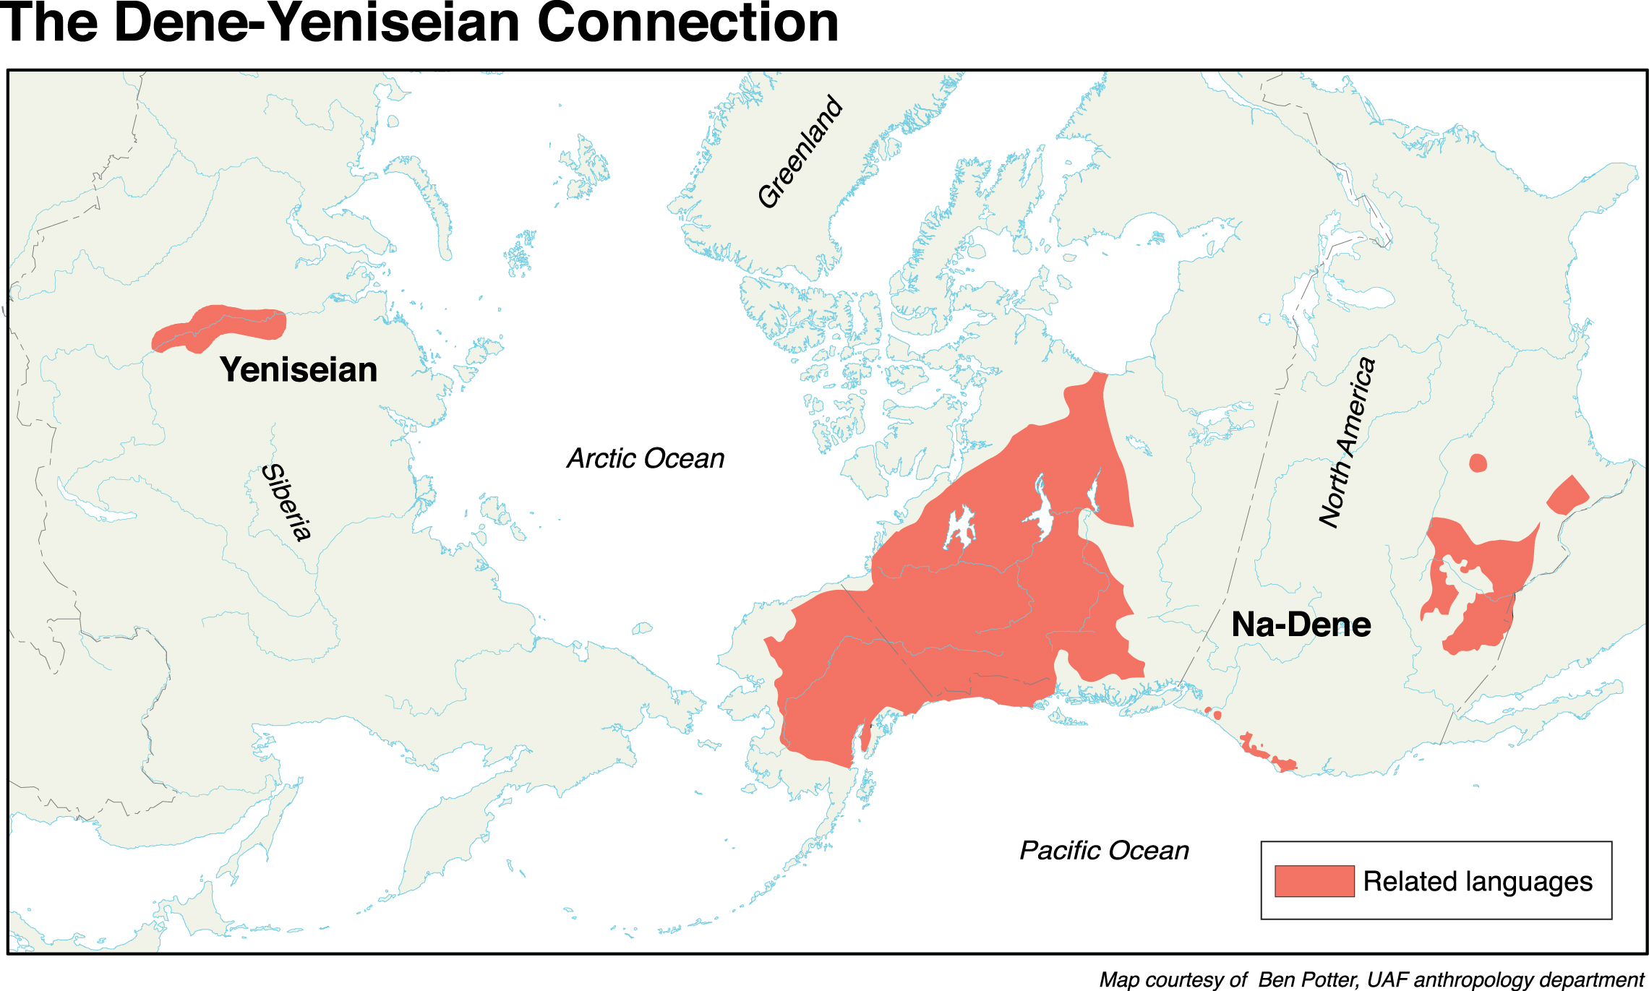
extinct
Yeniseian languages
Microblade tradition
Y-DNA haplogroup Q
Mt-DNA haplogroup A
Language ancestral to Ket and Na-Dene
Na-Dene ancestors (after 12,000 BP)
Stayed in northeastern Asia into the Early Holocene, long enough to acquire new Y-DNA haplogroup C3b moving up from East Asia.

Slide 41
A late Pleistocene spread of the Microblade (Dyuktai) Culture and its possible link with Y-DNA haplotype Q1 and Mt-DNA haplotype A could also be associated with Sino-Tibetan, but not with the other putative members of Dene-Caucasian.
The Chinese gene pool also contains the combination Q + A
And North China contains microblade artifacts.

Slide 42
Speakers of the south and west Eurasian Dene-Caucasian families do not share any special DNA connection with the three eastern families.

Slide 43
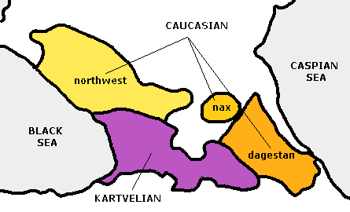
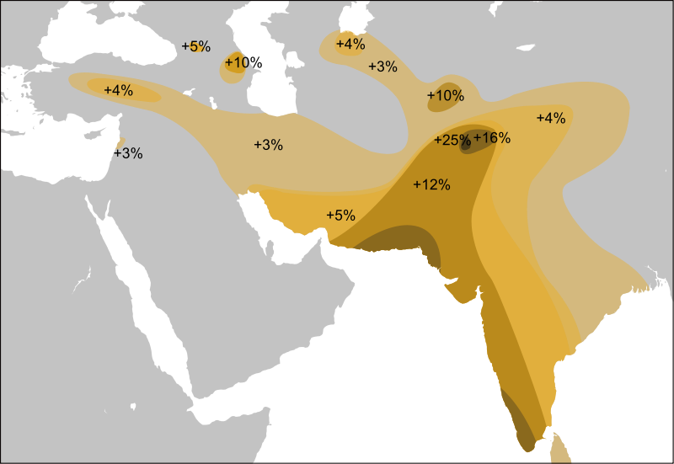
An unrelated human genetic connection
Burushaski speakers share a statistically significant incidence of a specific Y-DNA haplotype,
L-M357 with speakers of Nakh-Daghestanian.
Burushaski
Map showing general Y-DNA haplotype L

Slide 44
The issue of time depth.
Any connection between “Dene-Caucasian” families is likely to be older than 10,000 years.

Slide 45
Summary
Many aspects of the lexical and pronoun comparisons already proposed between various families included in Dene Caucasian look promising. More work should be done on this.
Without clear and non-controversial evidence of “shared innovations”, it is premature to conclude that any of these families are more closely related to one another, including “Dene-Yeniseian”.

Slide 46
3. Greater effort needs to be made in morphological reconstruction in each individual family.
4. Morphological evidence for “Dene-Caucasion” or its sub-branches should be sought, given the value of such evidence for distinguishing shared innovations from shared retentions.

Slide 47
5. Arguing genealogical relatedness between languages should not be the main focus of historical linguistics.
6. Demonstrating genealogical relatedness is a long and collaborative process. Critics and informed skeptics are collaborators.

Slide 48
7. Although non-linguistic data cannot demonstrate language relatedness, it is valuable to consider what is known about other disciplines in the study of human prehistory, to hypothesize about the logically possible time depth and location of connections between now distant peoples and languages.

Slide 49
Acknowledgments
George Starostin (RGGU) – for his invitation to the conference and his persistent collaboration with me over the past few years.
Matthew Anderson (Western Washington University office of Communications) – for filming this presentation as an overload to his schedule today.

