Slide 1
Proto-Mande reconstruction: State of the art
Valentin Vydrin
INALCO-LLACAN
Paris

Slide 2
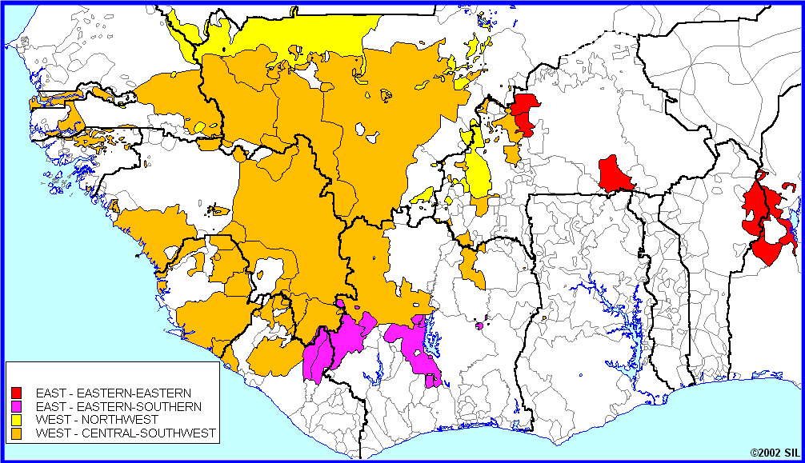
Mande languages

Slide 3
A reminder:
Mande < Niger-Congo,
60 to 75 languages, two branches:
Western: Manding, Mokole, Vai-Kono, Jogo-Jeri, Susu-Southwestern, Soninke-Bozo, Samogho, Bobo groups;
South-Eastern: Southern, Eastern groups.

Slide 4
Genetic depth
About 5300 years ago, separation of Western and Southeastern branches (17-20% between the most distant groups, Southwestern and Eastern, which corresponds to about 6000 years)
Daughter groups, 1000 to 3500 years: Manding 1200; Mokole 1500; Jogo-Jeri 1700; Southwestern 2000; Soninke-Bozo 3100; Southern 2600; Eastern 3100.

Slide 5
Proto-Mande phonological system
Some crucial features:
Nasal and ATR harmony;
No nasal consonants;
Implosive / sonants;
Highly probably, metric foot; different consonantal inventories in foot-initial and foot-internal positions.

Slide 6
9 oral and 5 nasal vowels; ATR and nasal harmony (domain: metric foot) Probably, phonologically relevant vowel length Syllabic types: *CV, *CVŋ (*CVN), N
+ ATR |  |  |  |  | –ATR |  |  |  |  | Nasal series
*i |  | *u |  |  | *ɩ |  | *ʋ |  | *N |  | *ĩ |  | *ũ
*e |  | *o |  |  | *ɛ |  | *ɔ |  |  |  | *ẽ |  | *õ
 | *a |  |  |  |  | *a |  |  |  |  |  | *ã

Slide 7
Consonants:
No phonemic nasal consonants (implosives and sonants have nasal allophones)
Opposition “implosive : explosive consonants”
Phoneme | /ɓ/ | /ɗ/ | /y/ | /w/
Oral allophone | [ɓ] | [ɗ] | [y] | [w]
Nasal allophone | [m] | [n] | [ɲ] | [ŋ]

Slide 8
The main argument for this system:
Quasi-absence of sequences “nasal consonant + semi-closed vowel” in Western Mande (ex.: Bamana)
PM |  | Bamana |  | PM |  | Bamana
*be | > | be |  | *ɓe | > | be
*bɛ | > | bɛ |  | *ɓɛ | > | bɛ
*bẽ | > | bɛ̃ |  | *mẽ | > | mɛ̃
*beŋ | > | bẽ |  | *ɓeŋ | > | bẽ
*bɛŋ | > | bɛ̃ |  | *ɓɛŋ | > | bɛ̃
*bẽŋ | > | bɛ̃ |  | *mẽŋ | > | mɛ̃

Slide 9
All Mande languages are tonal
Western Mande: 2 level tones (exceptions: Southern Kpelle, 3 tones; Samogho group, 3 to 4 tones; Bobo, 3 tones)
Southeastern Mande: 3 to 5 level tones
Proto-Mande: presumably, 2 level tones.
Tonal split in daughter languages through tone-depressor consonants (ex.: Guro; probably, Boko) and foot compression.

Slide 10
Noun morphology reconstructon
Noun morphology in modern Mande languages is scanty and/ or innovative.
No noun classes.
Some remnants of classificatory morphology (not necessarily noun classes):

Slide 11
Nasal prefix *Ǹ- (small objects, dangerous objects... etc.), reflexes:
prenasalization of certain nouns in Bamana, Mandinka;
perturbaton of initial consonant alternation in Southwestern Mande
no article/noun morpheme in numerous Western Mande languages
irregular correspondences in Southern Mande.

Slide 12
Nouns for elder relatives:
“strong” unalterable initial consonants in Southwestern Mande;
special plural marker *-NI in SWM;
no article/noun morpheme added in numerous Western Mande languages.
Reconstruction: prefix *Ń-, pl. suffix *-ni (?).

Slide 13
Opposition “alienable : inalianable” (“free noun : relational noun”)
To be reconstructed for the Proto-Mande.
The alienable possession markers are variable in the Mande languages and stem from different locative postpositions. Cf. Dan where different possessive markers encode opposition of cases (ɓȁ common case vs. gɔ̏ locative case), an evident innovation.

Slide 14
An intriguing evidence:
Proto-Southwestern Mande agent noun suffix:
Sg. *–mɔ,
Pl. *–bèlà.
Are these forms to be traced back to the Niger-Congo 1 and 2 class markers?

Slide 15
Pronominal morphology
Single paradigms in the Central Mande (Manding, Mokole, Vai-Kono, Jogo-Jeri, Soninke-Bozo).
Multiple paradigms (different syntactic functions, pragmatic and TAM semantics) in Southwestern Mande, Southern and Eastern Mande, Bobo.
Reconstruction of pronominal systems: Proto-SM (Vydrin), Proto-SWM (Babaev); a tentative Proto-Mande reconstruction (Babaev).

Slide 16
Verbal morphology
Very little derivational morphology in modern Mande languages:
-ndi causative suffix in Mandinka, -ndí in Soninke, -ni in Bozo;
antipassive ndì in Soninke, -rí in Mandinka.
Creissels’ hypothesis: from the verb *tîŋ ‘do’ (?).
Decausative suffix –E in Soninke, Bozo (in a fossilized form, also in Bobo).

Slide 17
Further derivational morphology:
-be causative suffix in Bobo, -ke causative suffix in Gban (Southern Mande).
Verbal locative suffix *-Lá in Southern Mande, *-LƐ in Busa-Bokobaru (Eastern Mande) < probably from adverb *tá ‘there’ (Idiatov 2008).
Verbal prefixes in Manding, SWM, SM, Susu, etc. are innovations.

Slide 18
A preliminary conclusion:
The scanty verbal derivative morphology in Mande languages is innovative, there is hardly anything that can be reconstructed for the Proto-Mande level.

Slide 19
TAM morphology
Basic word order:
S Aux DO V-mrph
Two major slots form auxiliary morphemes: Aux, -mrph.
Majour sources for Aux: copulae, motion verbs, verb “do”.
Sources for –mrph: locative postpositions, converb suffixes.
Reconstrcutions: Proto-SM TAM (Vydrin); Proto-SWM TAM (Babaev, in progress).

Slide 20
Some candidates for the PM-level reconstruction, position Aux:
TE, negative copula
BE, affirmative locative copula
MU, presentative/ identification copula

Slide 21
Candidates for the PM level, slot -mrph
Gerund marker *-ɗɩ
Perfect marker –DA.
Everything else is presumably innovative (to be verified!).

Slide 22
A preliminary conclusion:
The main bulk of evidence pro or contra NC origin of Mande lies in the field of the lexical + phonological reconstruction. The morphology reconstructable for the Proto-Mande language is too scarce to serve a proof of anything (which does not mean that a reconstruction of the Mande morphology is useless!).

Slide 23
Phonological reconstruction: mainly initial consonants
Reliable reconstructions:
Proto-Southwestern
Proto-Southern
Proto-Manding (to be updated in certain fragments), initial + internal consonants + vowels
Less reliable:
“Proto-Western” (in fact, SWM + Susu + Manding + Vai-Kono) by R.Kastenholz;
- “Proto-Eastern” by H.Schreiber (rather unreliable).

Slide 24
Lexical reconstruction
Comparative database, about 3280 comparative series by March 2013 (of various degree of elaboration), of these presumably 500-600 represent more or less probable candidates for the Proto-Mande level.
Groups and languages whose data is systempatically imputted: Manding, SWM, SM, Susu-Jallonke, Soninke-Bozo, Vai.
A Swadesh’s 100 wordlist for all the languages of the Mande family.

Slide 25
Sample entry from the comparative database: *bɛ́nbá
SWM: Mende IN mbémbá/? (?) n lineage, family, Kpelle-Guin. JL ɓɔmɔ-kɔlɔ/?, ɓɛmɛ-kɔlɔ/?, pl. -li or -ɣa n ancestor (of the same clan)
Soso SF, TU bénbá, -ø rn ancestor, forefather; grandfather; MJ great-grandfather,
MOKOLE: Lele VV bénba rn grandfather, Koranko KZ bénba rn ancestor, forefather
P.Manding *bÉnbaa, Mandinka DC, MD bénbaa rn ancestor, Nyokolo Maninka GM benbaa rn ancestor, Xasonka TD bénba rn ancestor, Kita Maninka DC bénba rn grandfather (no article), Maninka bénba rn ancestor, forefather; grandfather (on both lines), Bamana bɛ́nba, Bamana (s) bɛ́ma rn ancestor, forefather
Bobo BB bɛ̄mā
South Mande (< Manding?) Dan (bl) ɓɛ́má, Dan (gw) ɓɛ̋ma̋ rn ancestor, Tura # ɓɛ̋ma̋

Slide 26
Sample entry: *yɛ̀lɛ́ ‘hole’
SJ: Soso SF yili, Jallonke FL jìlí
JOGO-JERI: Jogo JG yélì
MOKOLE *yele > Lele # kán-yili throat, Koranko KZ ká̰-yele rn throat; oesophagus
EAST MANDE: Bisa-Barka PR yer
SOUTH MANDE *yɛ̀lɛ̀ > Dan (gw) yɛ̏(-gā), Dan (kl) yɛ̏ n orifice, hole, Tura # yɛ̀ɛ̀, Guro #, BN yɛ̄lɛ̄ n hole (of animal), burrow, Yowre EK yɛ̏lɛ̏, Ben # yrɛ̄

Slide 27
Sample entry: *Ǹ-dóoléŋ̀ ‘hook’
SWM *ndóolíŋ, Mende IN ndólí/? n fish-hook, Loko IN, RS ndóí(ŋ)/loi(ŋ), Bandi RG ndòolí(ŋ)/looli(ŋ) Zialo BA dòolì(g)/looli(g) n fishing rod
SUSU-JALLONKE: Jallonke FL dòlíǹ
JOGO-JERI: Jeri KZ dúlén-dì
VAI-KONO: Vai WW ɗó'í, Kono-SL KZ dóin
MOKOLE: Lele VV lún-julu n fishing rod, Koranko KZ lóḛ, lúyḛ n fishing rod
MANDING ǹ-dóolen (?), Mandinka DC dóoliŋ, MD doliŋ n fishing rod, Xasonka TD dòlliŋ, Kagoro (g, km) dóolḛ, Kagoro (sb) dó̰o̰le, Kagoro (gs, ju) dóole, Kagoro (kg) dóoli, Kagoro (sf) dóolo, Maninka dólḛ, dúlḛ, Bamana dólḛ, ǹdólḛ n fishing hook; fishing rod, Kong Jula GA dúlḛ
SONINKE-BOZO: Soninke SM dooliN/dooliŋŋe, pl. -u n fishing rod; fishing line with many hooks on it, Tieyaxo KZ jílân, Sorogama LA jáán
SAMOGO: Seeku PR jòllèn
SOUTH MANDE: Guro #, BN dūlē n fishing rod, Mwan # dúléŋ́, Ben # dúwléŋ́ n fishing rod

